Slide 1
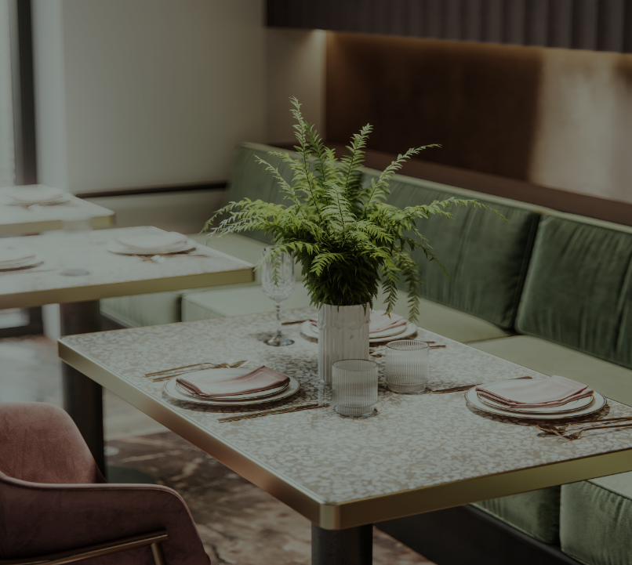
ONLINE FOOD ORDERING SYSTEM
By
Adarsh K
Ayonabha Chandra
Darshan C S
Harkamal Singh
Preethi G

Slide 2

About OUR PROJECT
The Project contains 2 interface.one is for admin and another is for User.In admin part the admin can add,delete,update and the view the orders.In user part the user can view and order the food item and add to cart.In This project we have used.MVC&ASP.NETFrameworks.ASP.NET is used for Admin part and MVC is used for User part.

Slide 3

PROJECT overview
Company

Slide 4
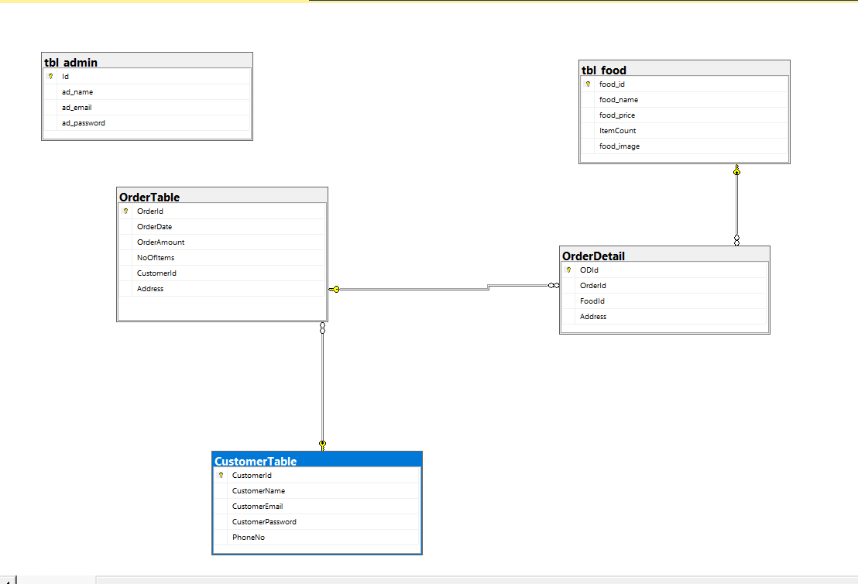
Company

Slide 5

In online food ordering system, there are two modules –
Admin
User or Customer.
Admin is a responsible person who operate the whole system. Admin has rights to add, delete, modify category , item and all other information regarding to online food ordering system.
User is a visitor of our website, who visit the site and make some order for food by making online payment or cash on delivery option.
HOME PAGE:
Displaying the food items where user can order the food online.
Contains panels for Login, Signup, About and Menu.
Then user has to enter the details to order the food.
After login, user can choose a particular food item by adding to cart.

Slide 6

Thank You
Than

Slide 7
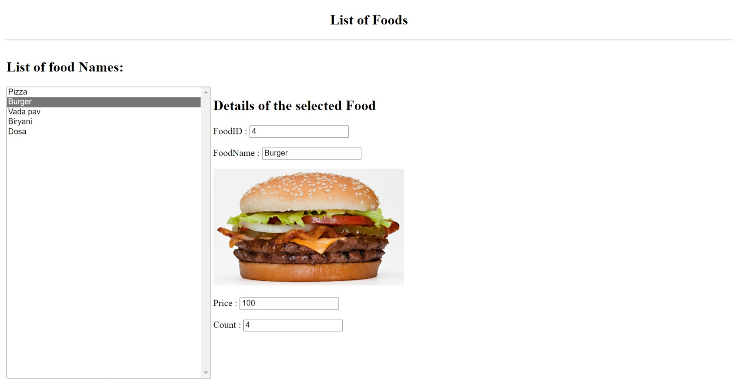
Admin Page
Display the list of food

Slide 8
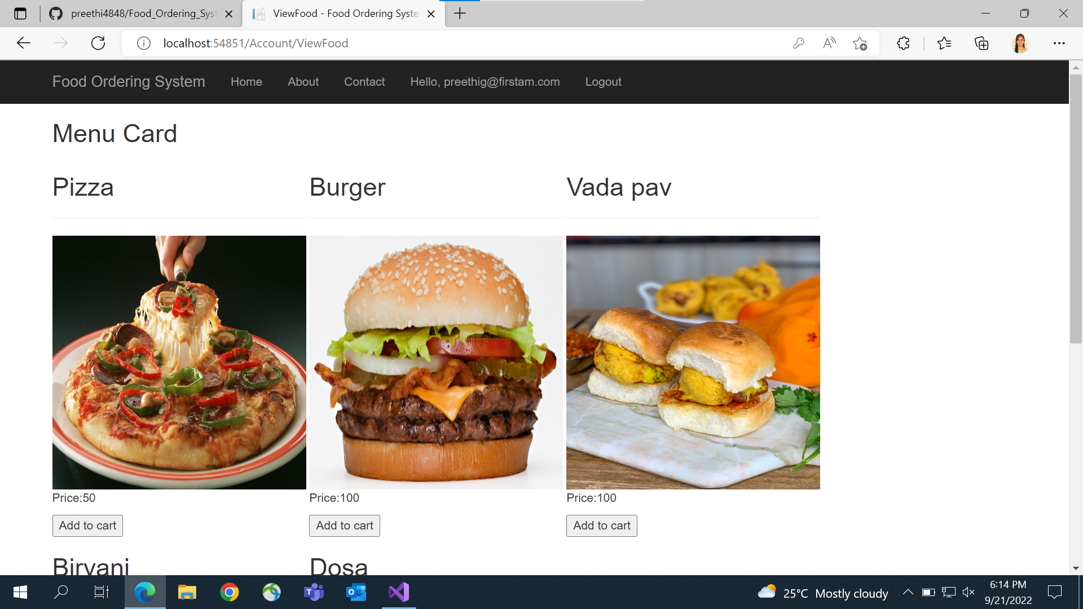
Customer Page
Menu of food

